Slide 1
Bwapp建置

Slide 2
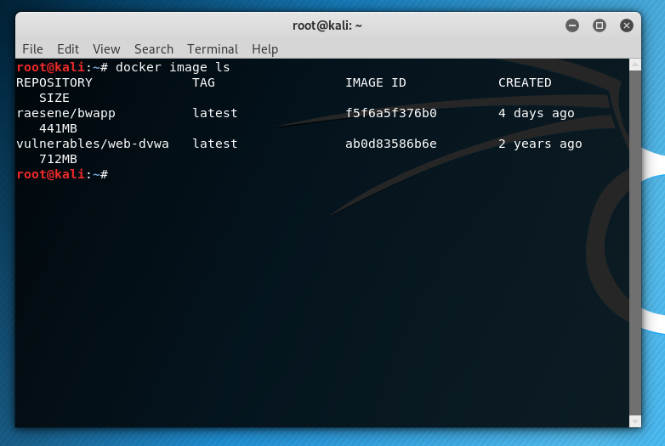
Docker image ls

Slide 3
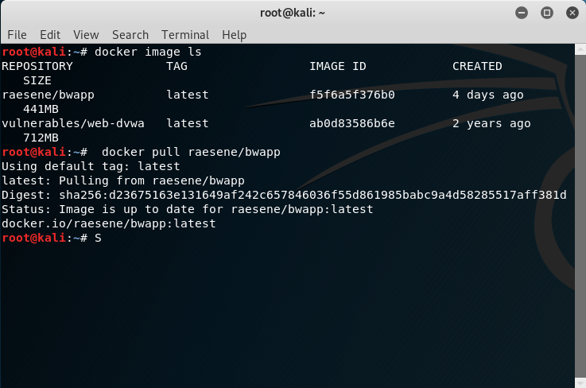
docker pull raesene/bwapp

Slide 4
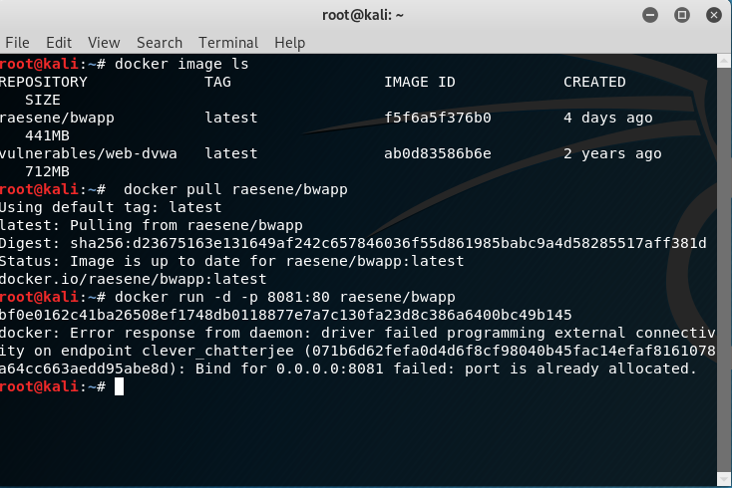
docker run -d -p 8081:80 raesene/bwapp

Slide 5
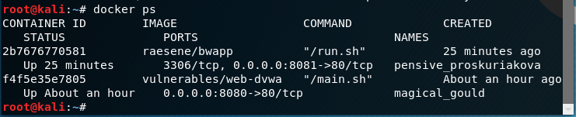
Docker ps

Slide 6
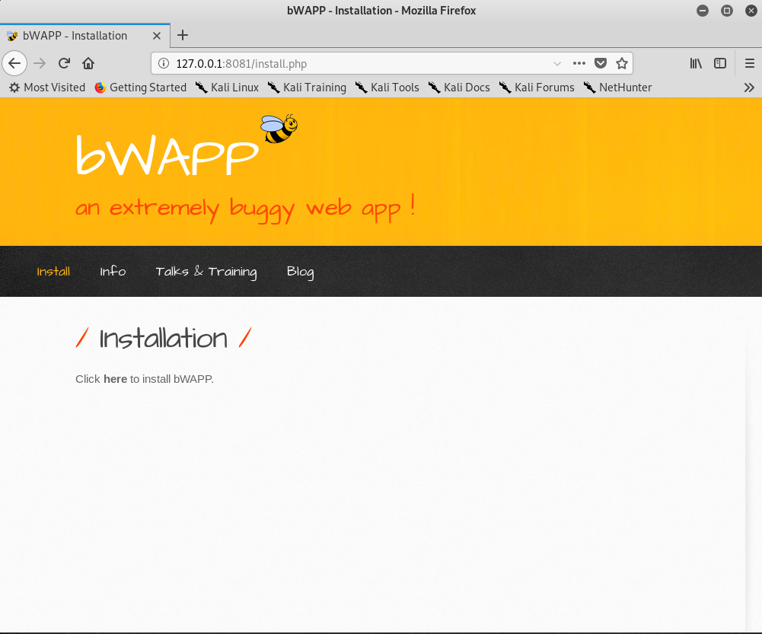
http://127.0.0.1:8081/install.php

Slide 7
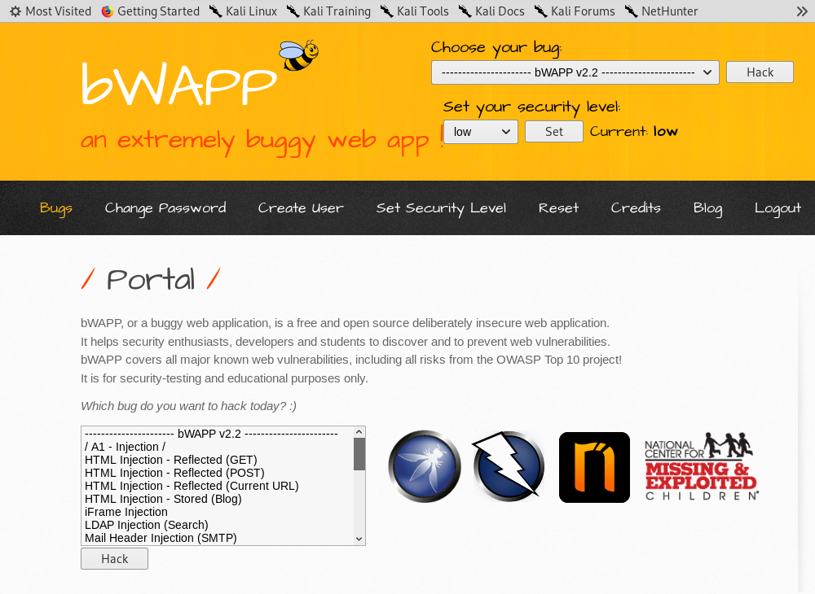
Bee/bug

